Slide 1
DSA masterclass
Become a DSA expert + a good problem solver. Tips from experts
30dayscoding.com

Slide 2
Important points
DSA is about problem solving and not just leetcode
Use DSA as your advantage instead of complaining
No need for CP (right now) if you are not confident with 250+ questions
No need of a course if you know the basics
Stop pasting solutions and watching videos without TRYING
Stop comparing your journey to others
No, you don’t need to solve 1000 questions
No, you don’t have to be a born genius
I cleared 40+ DSA interviews and you can too!

Slide 3
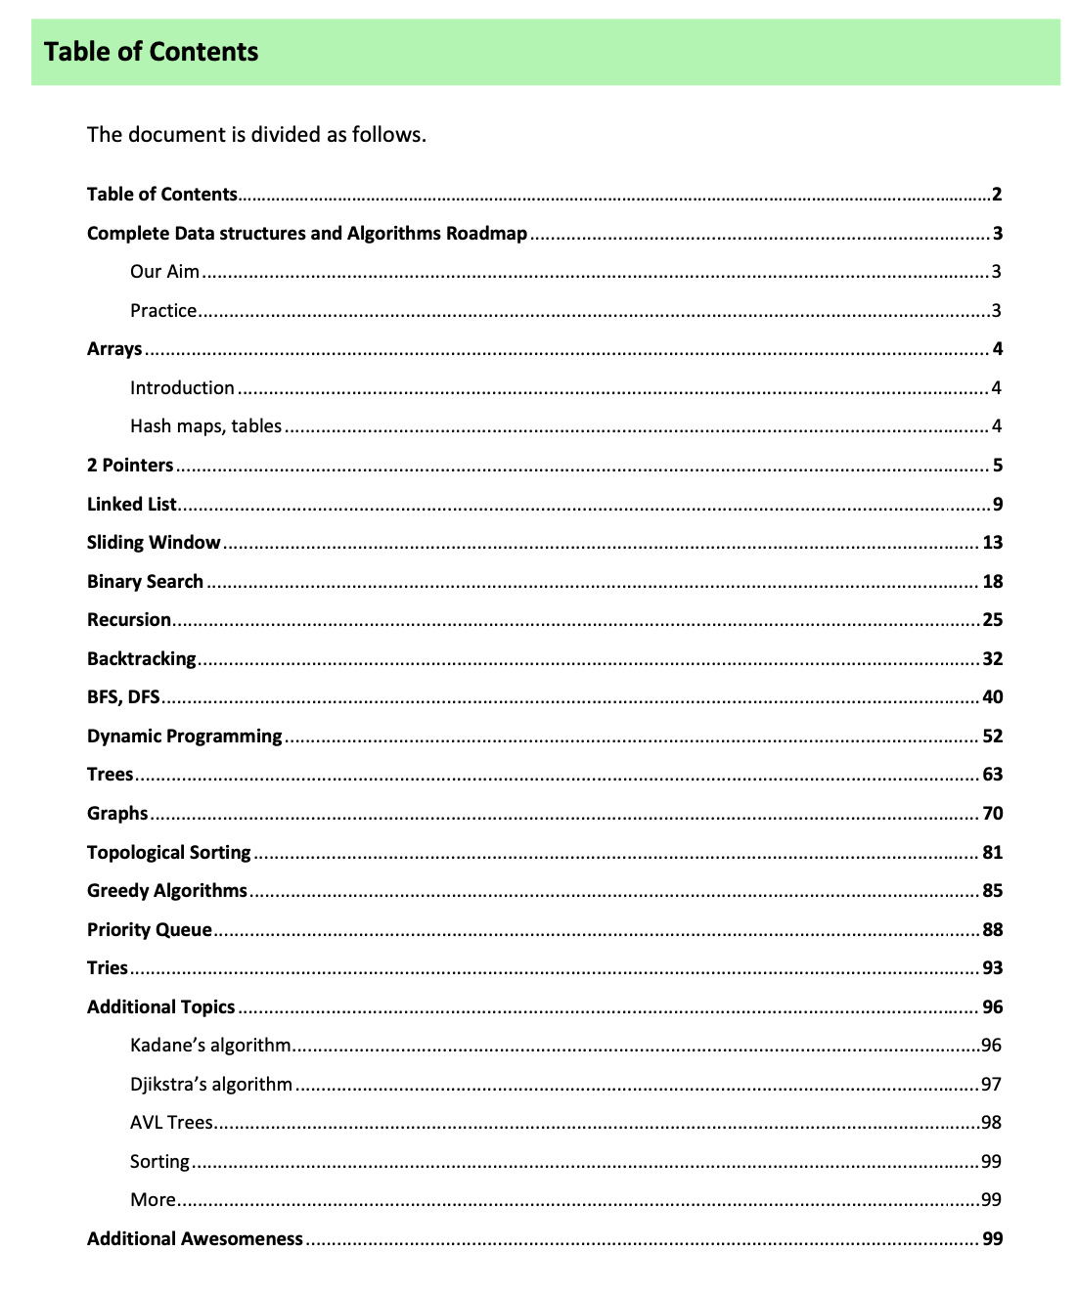
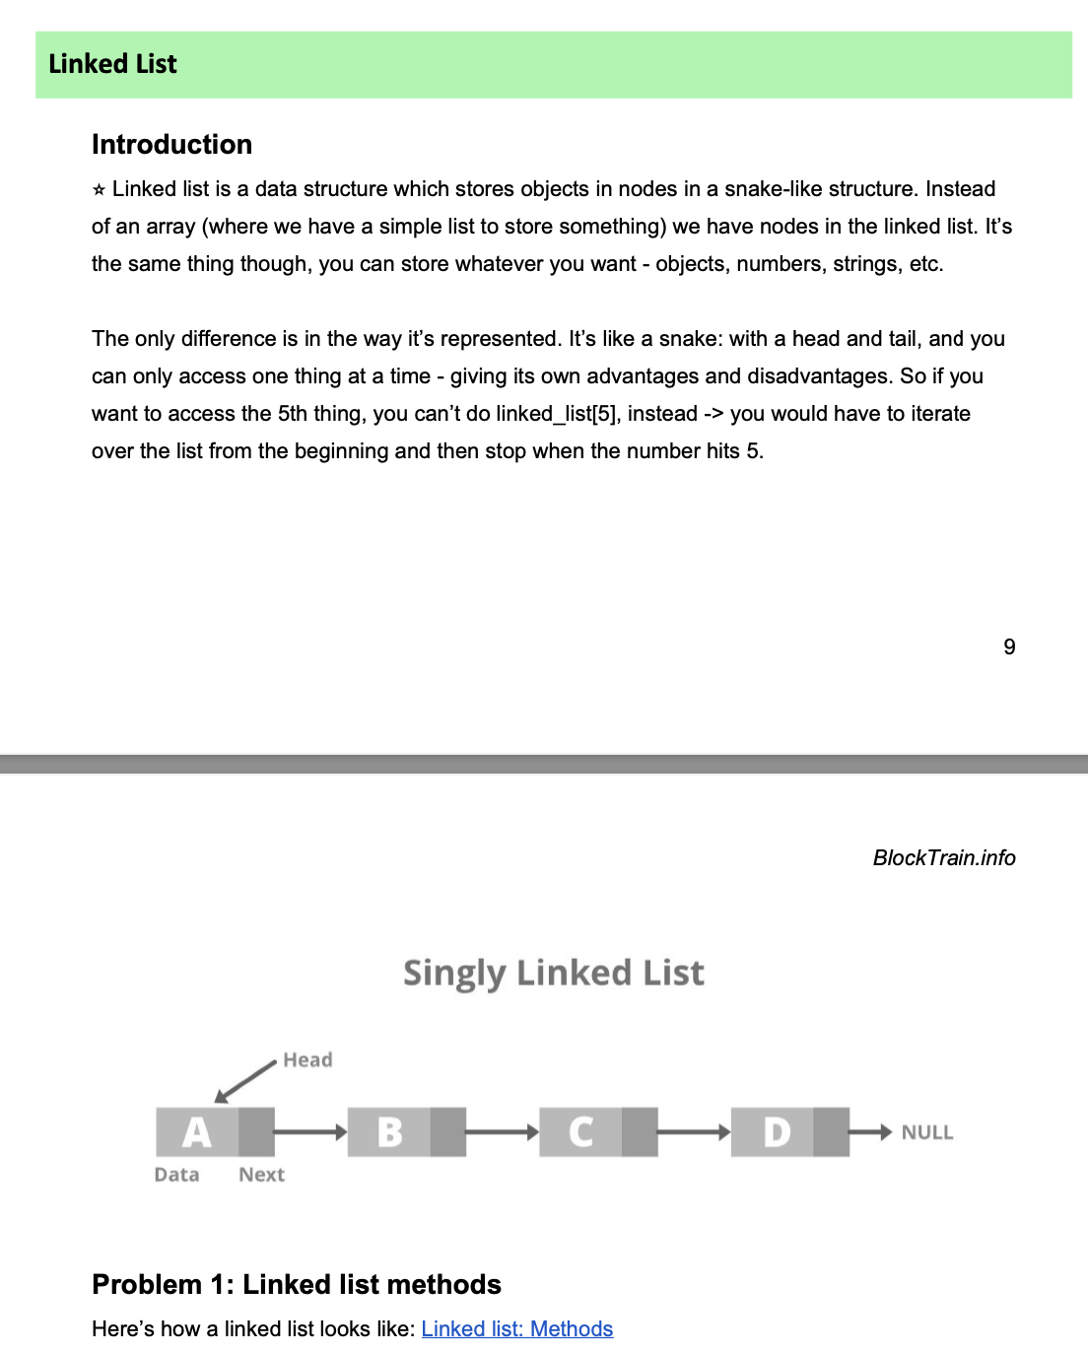

Slide 4
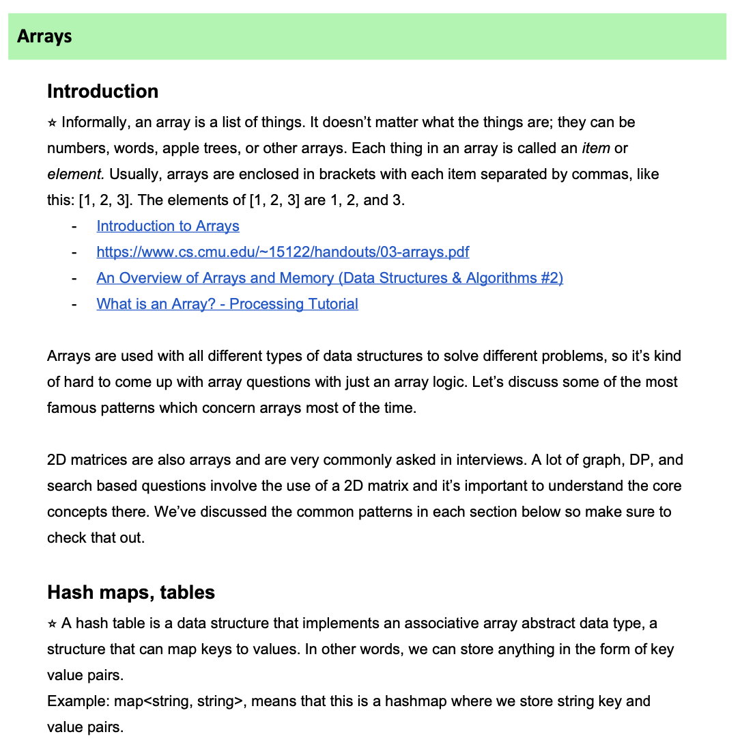
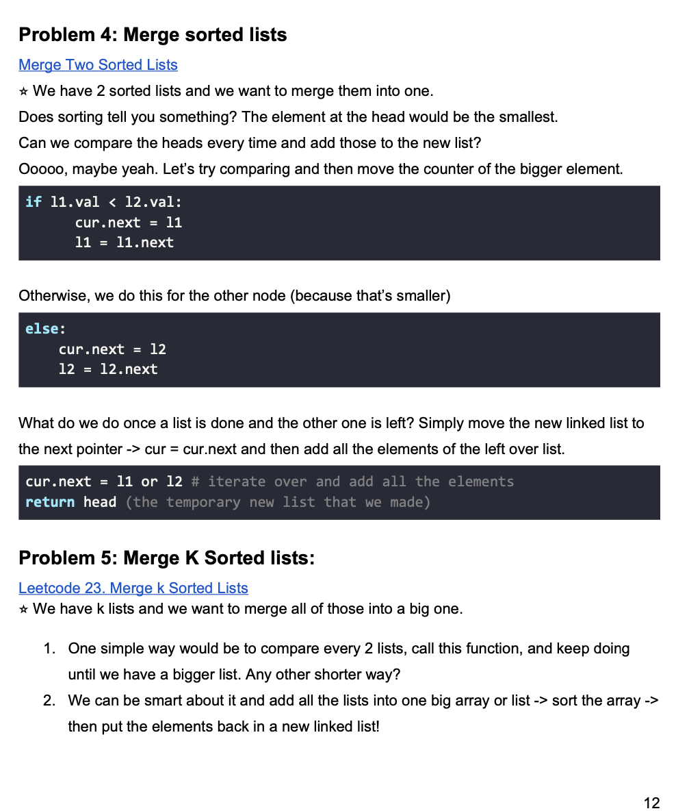

Slide 5
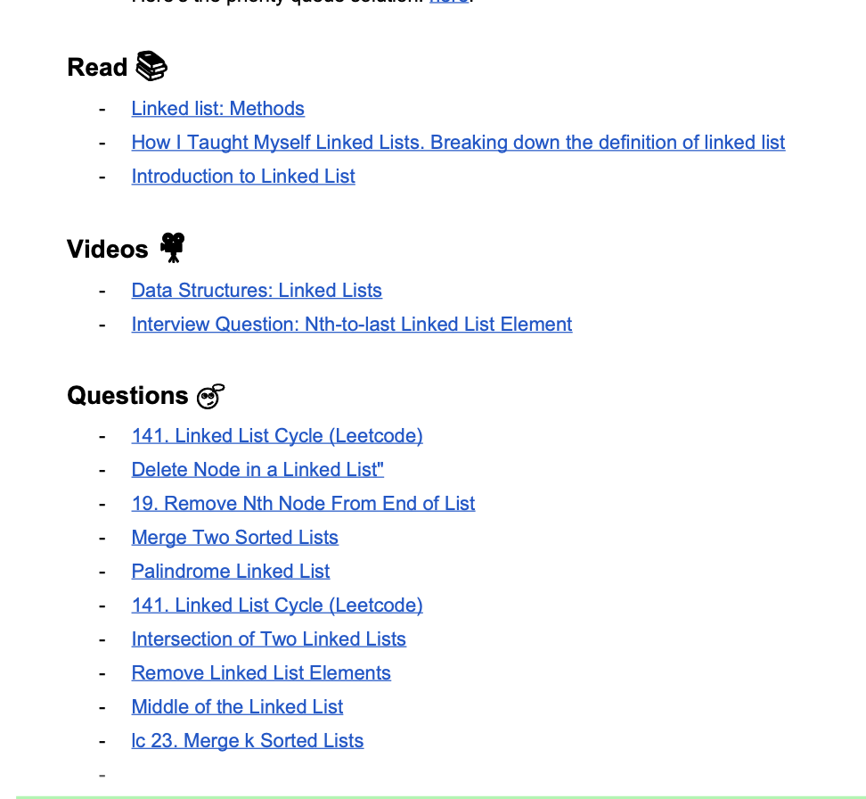
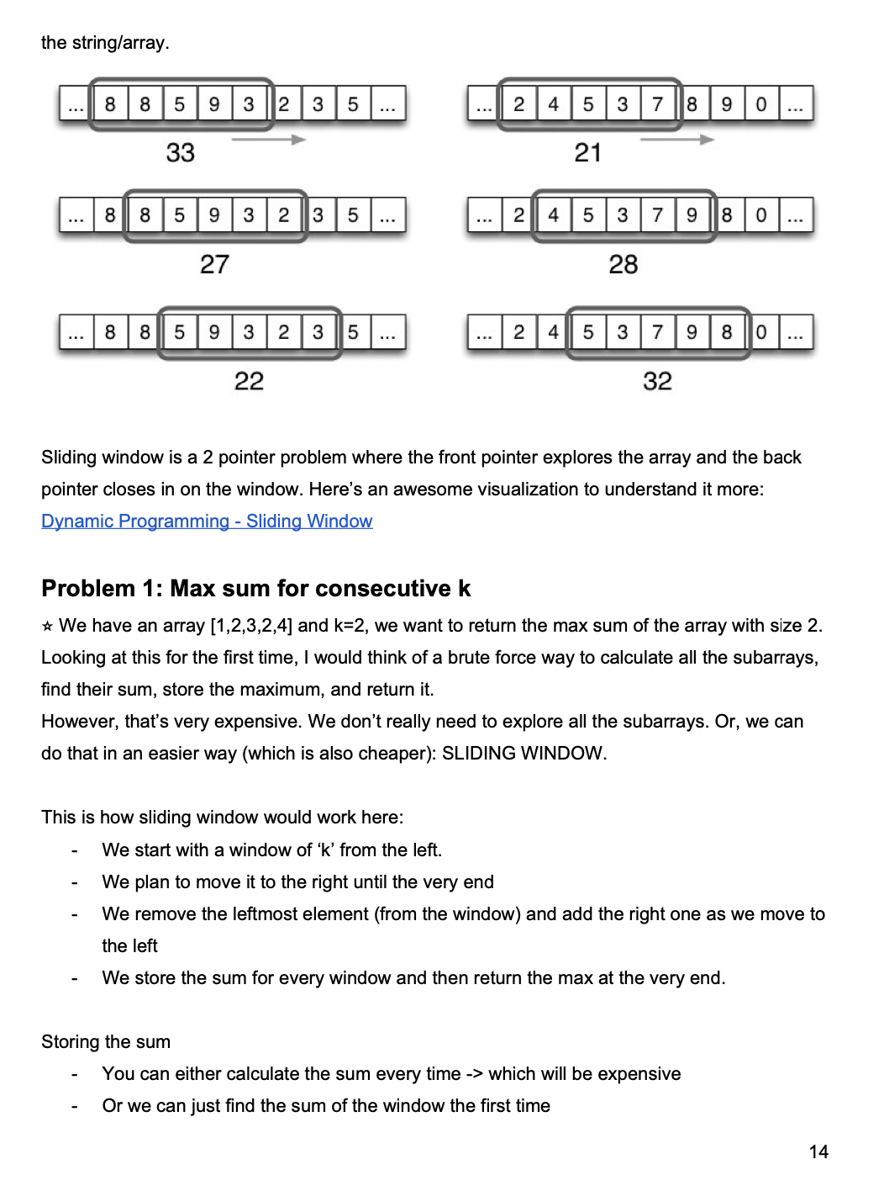

Slide 6
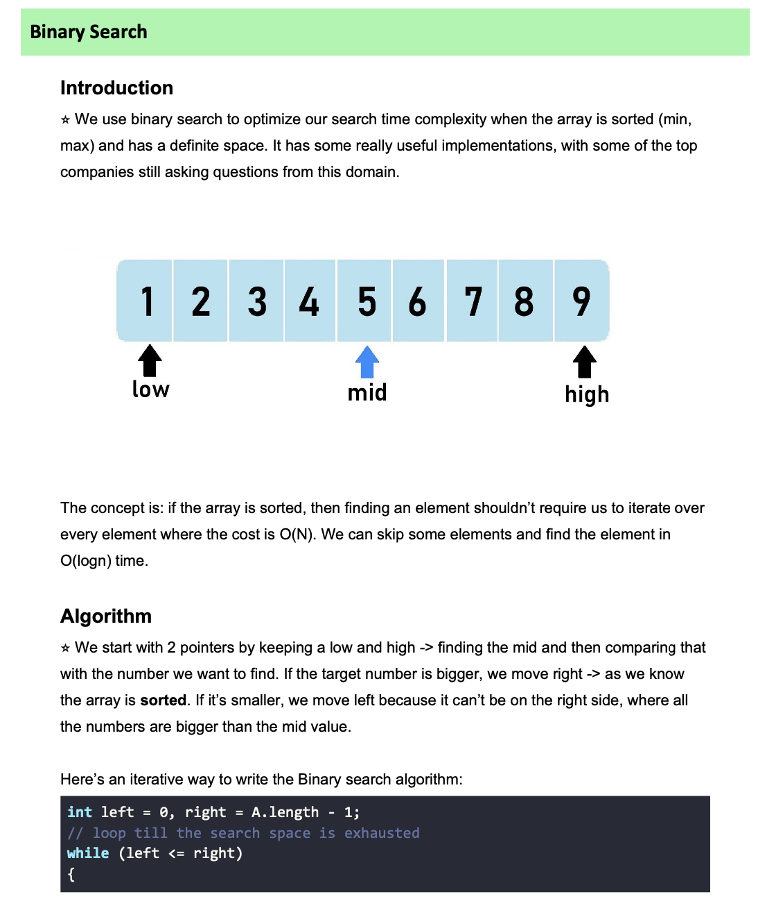
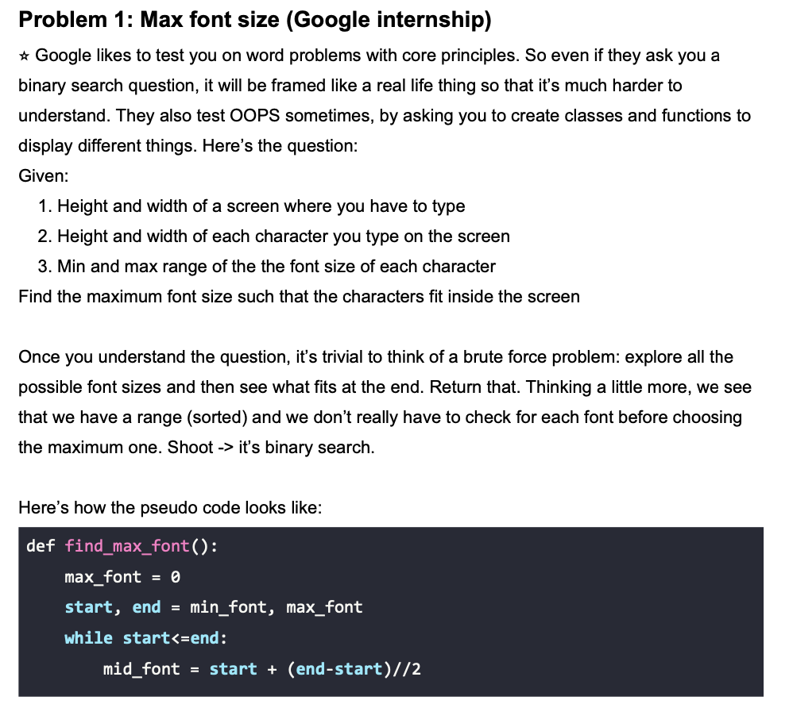
BINARY SEARCH

Slide 7


Slide 8
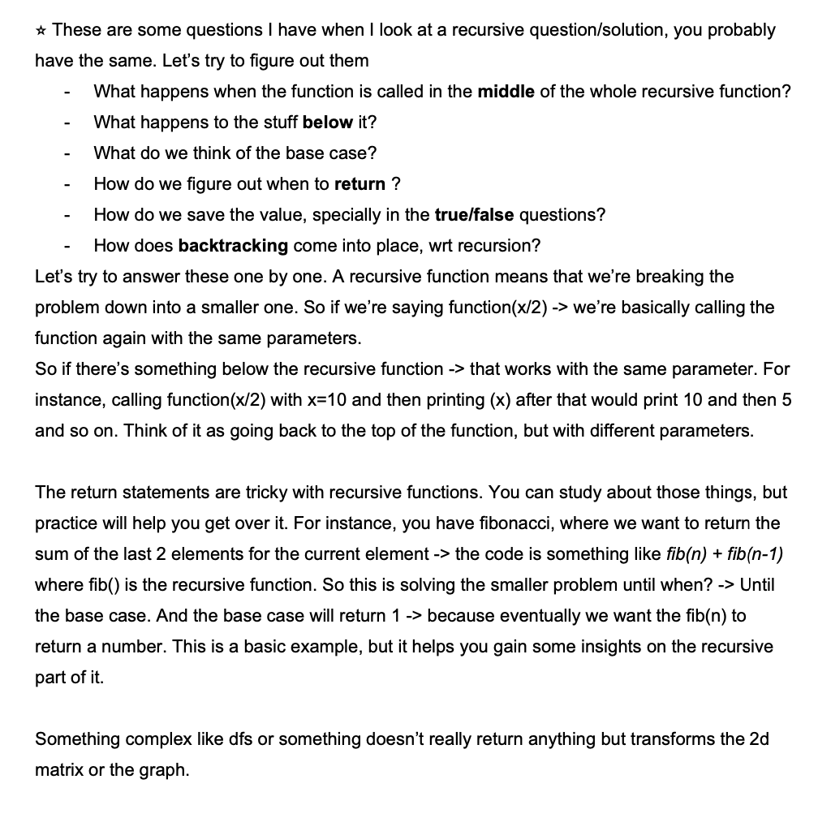
RECURSION
V v v important topic
Read every line
Understand every pattern
This is the basis for backtracking and DP - 2 very important topics
Don’t skip questions
Make notes
Solve 25+ problems

Slide 9
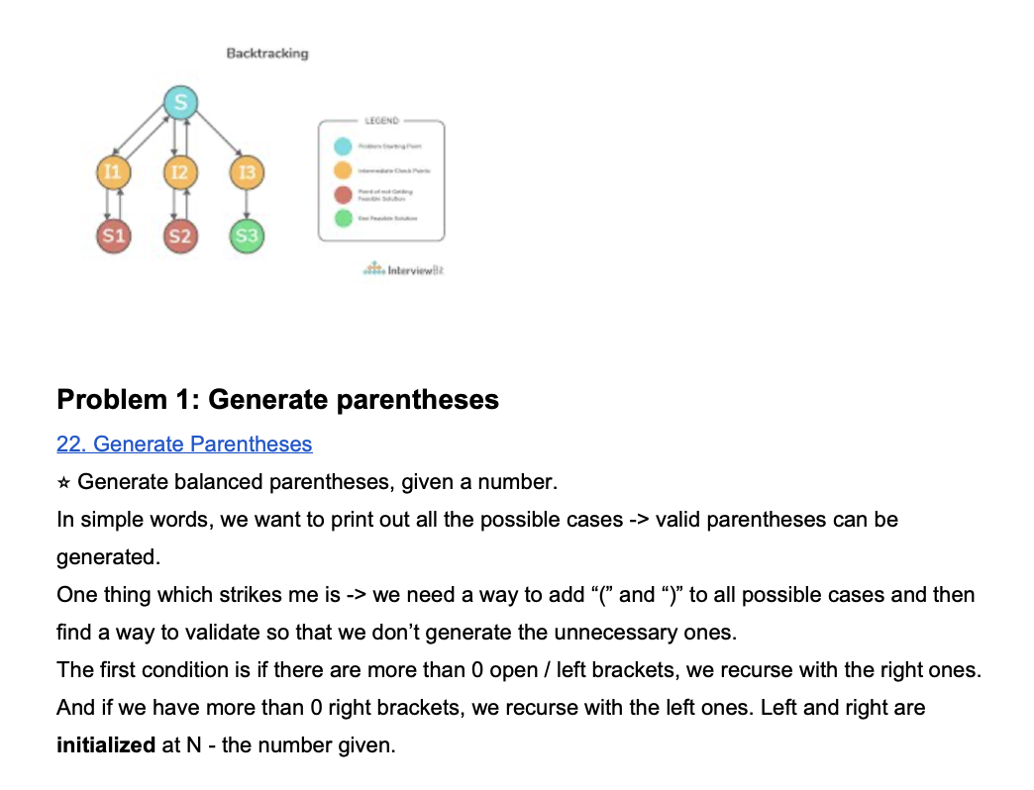
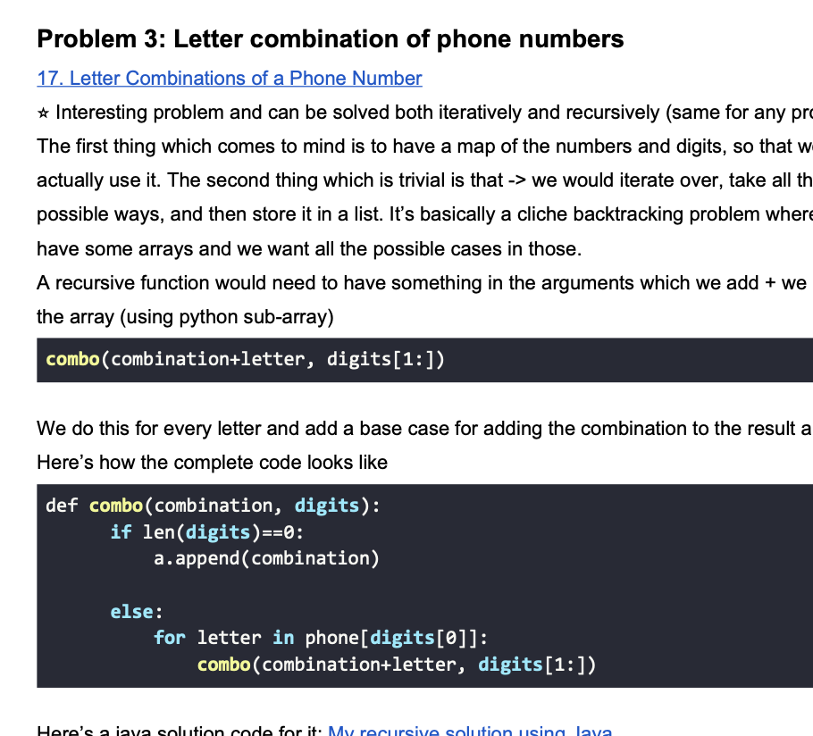
READ AND UNDERSTAND PATTERNS.
Copy pasting doesn’t help
Reading doesn’t help
Understanding helps

Slide 10


Slide 11
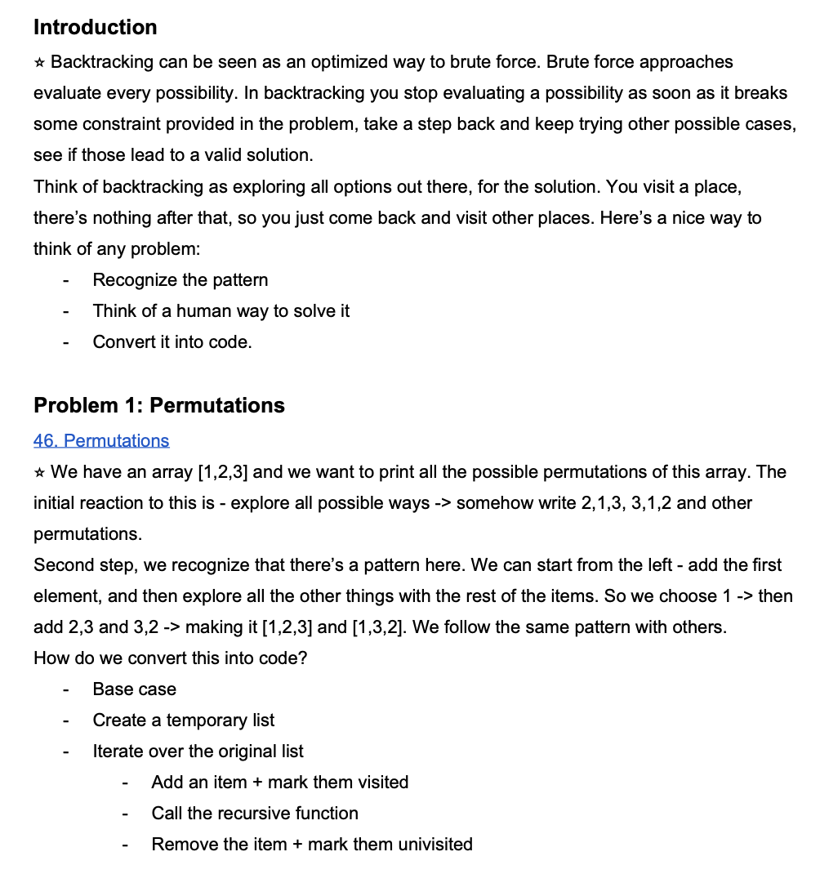
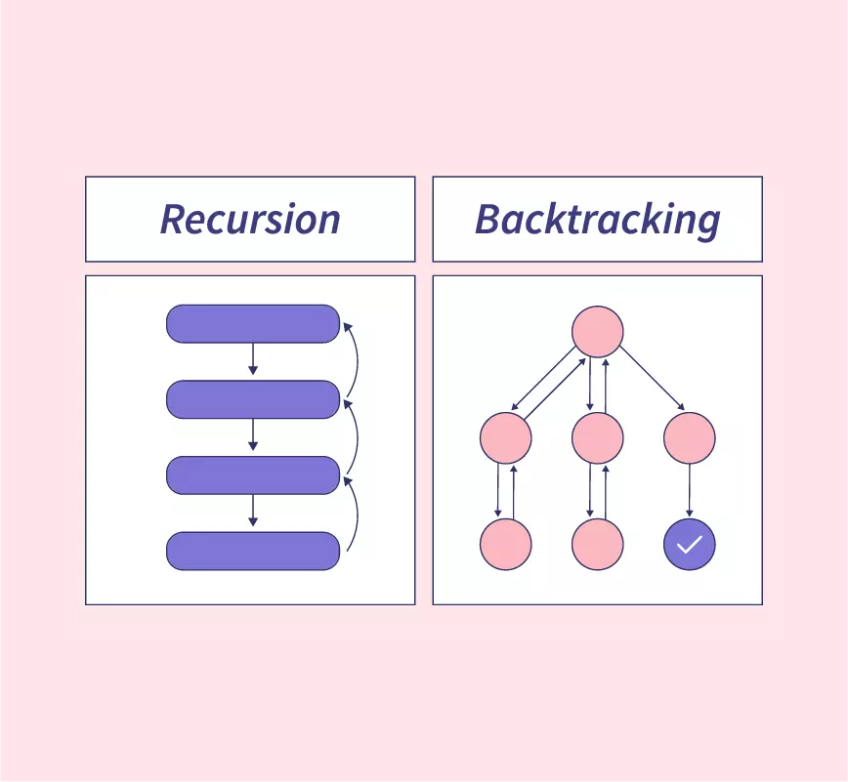

Slide 12
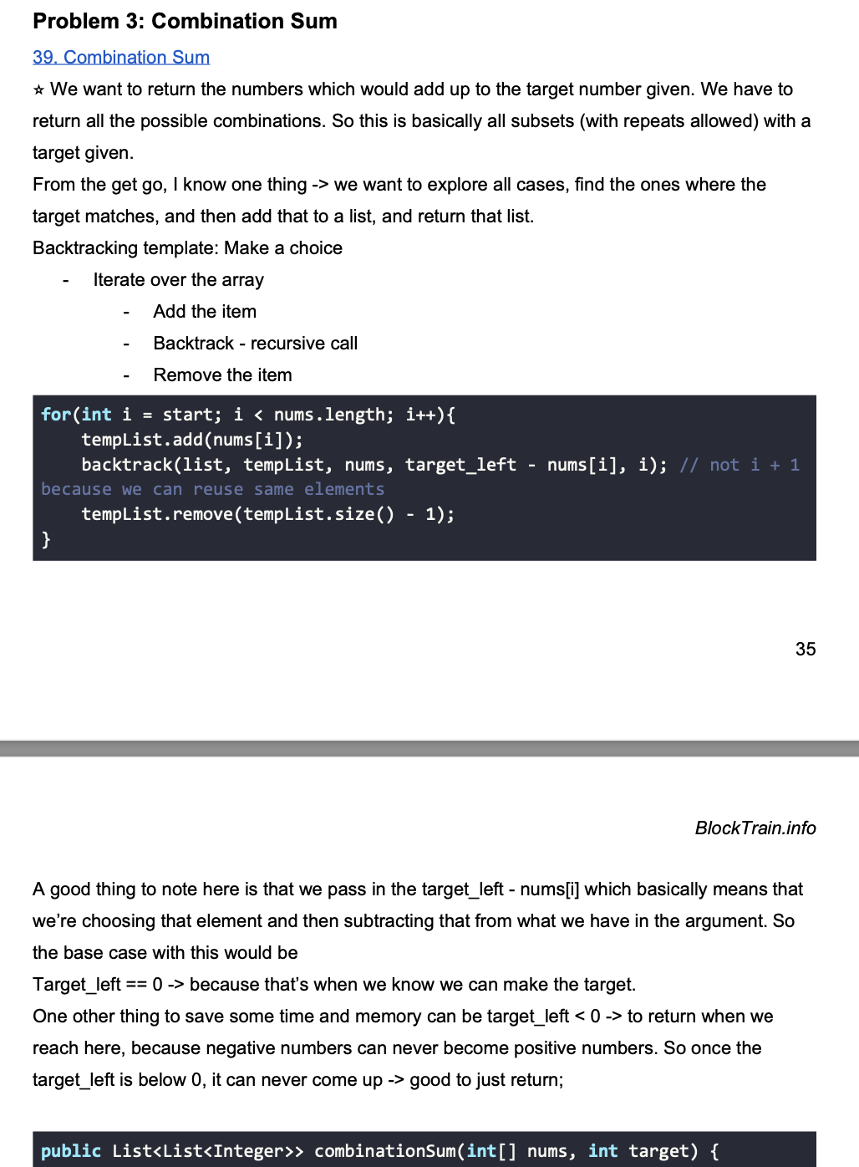
Backtracking is v v important pattern / algo / etc
Used in real life use cases
Finding cheapest flights/shoes/etc
Finding fastest etc
UNDERSTAND THE PATTERN HERE
Push, recurse, pop is a famous pattern
We use the element
Recurse and solve for it
Then remove it
Read every word and line from this.

Slide 13
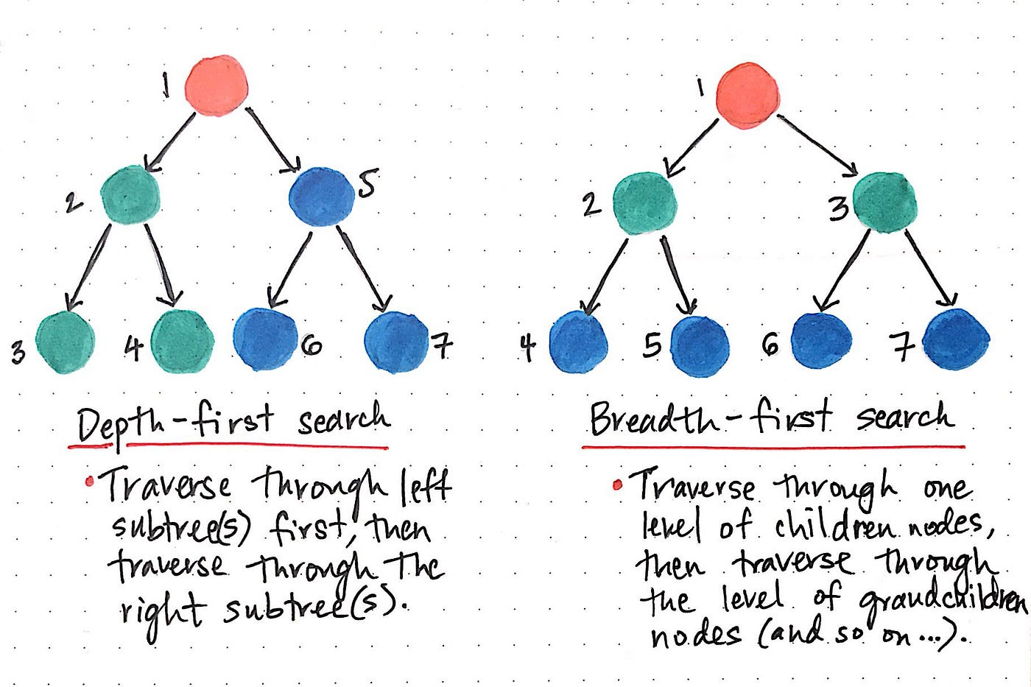

Slide 14
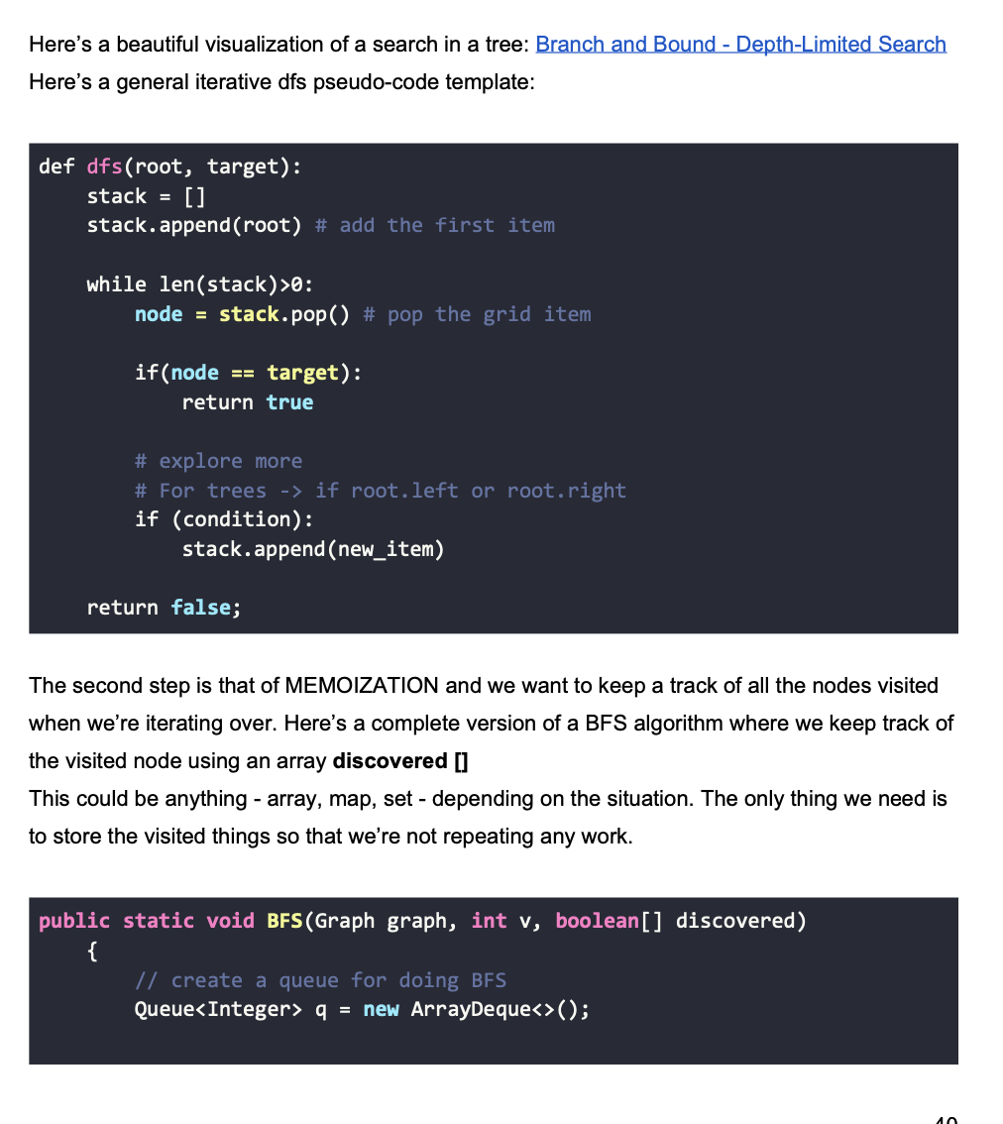
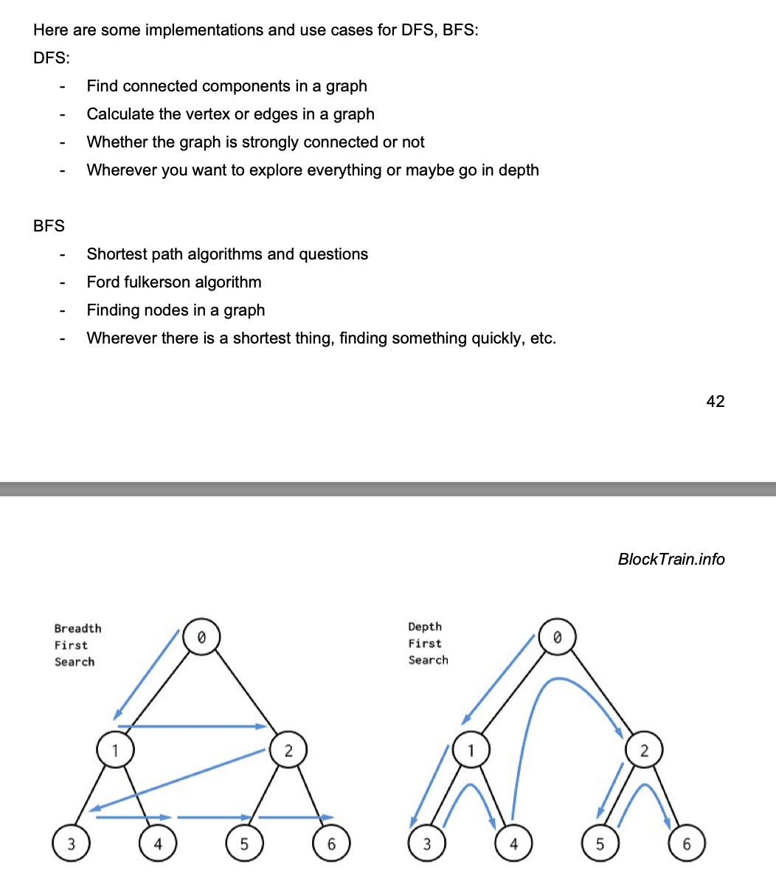

Slide 15
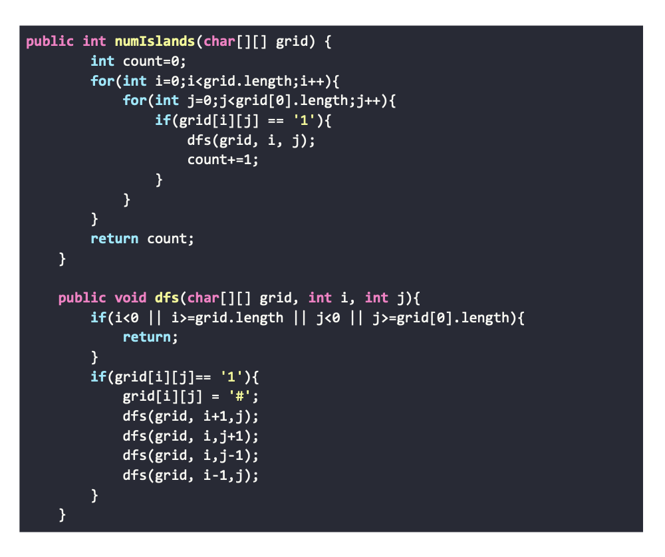
The most important DFS problem - number of islands.
Use a pen and paper
Make a diagram
Visualize how things are working
Solution
Iterate, change the number
Count the islands
Change it back
Do it for all the indexes

Slide 16
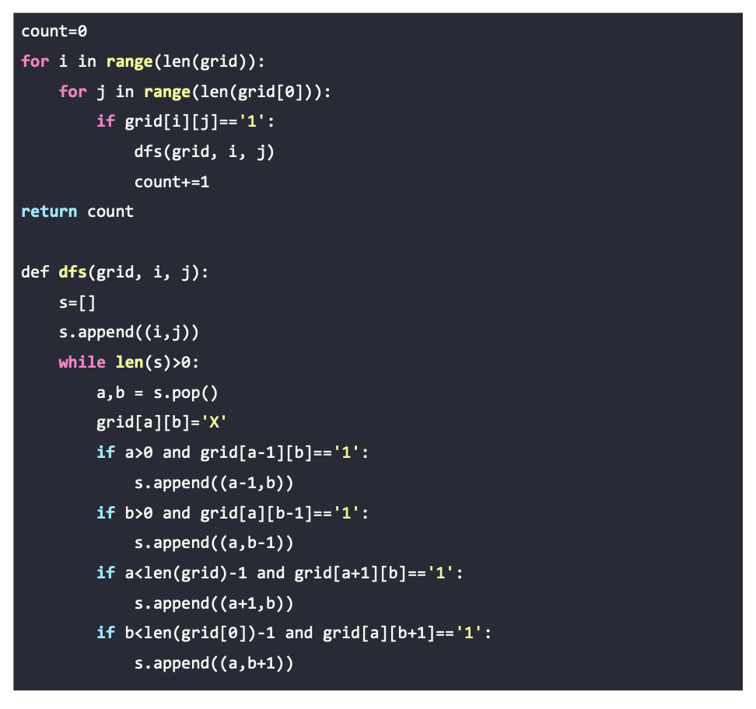
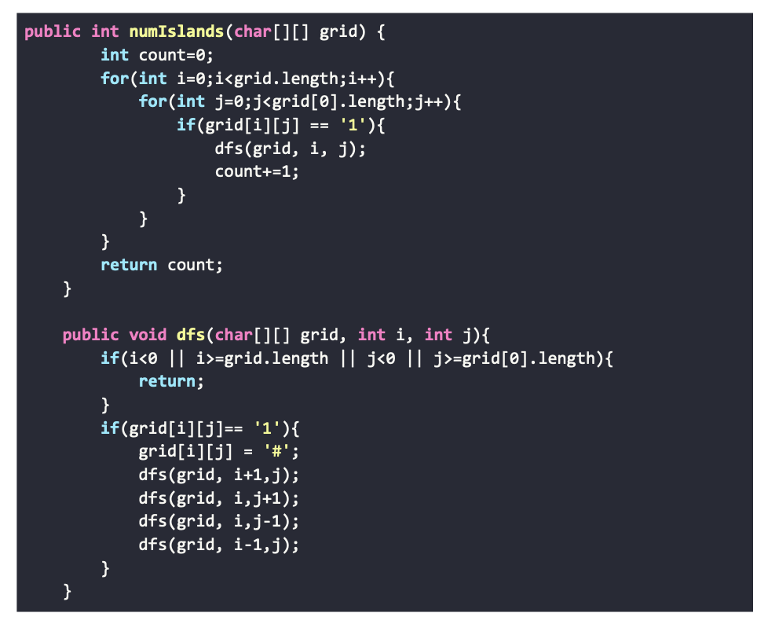
ITERATIVE VS RECURSIVE
SOLVE USING BOTH

Slide 17
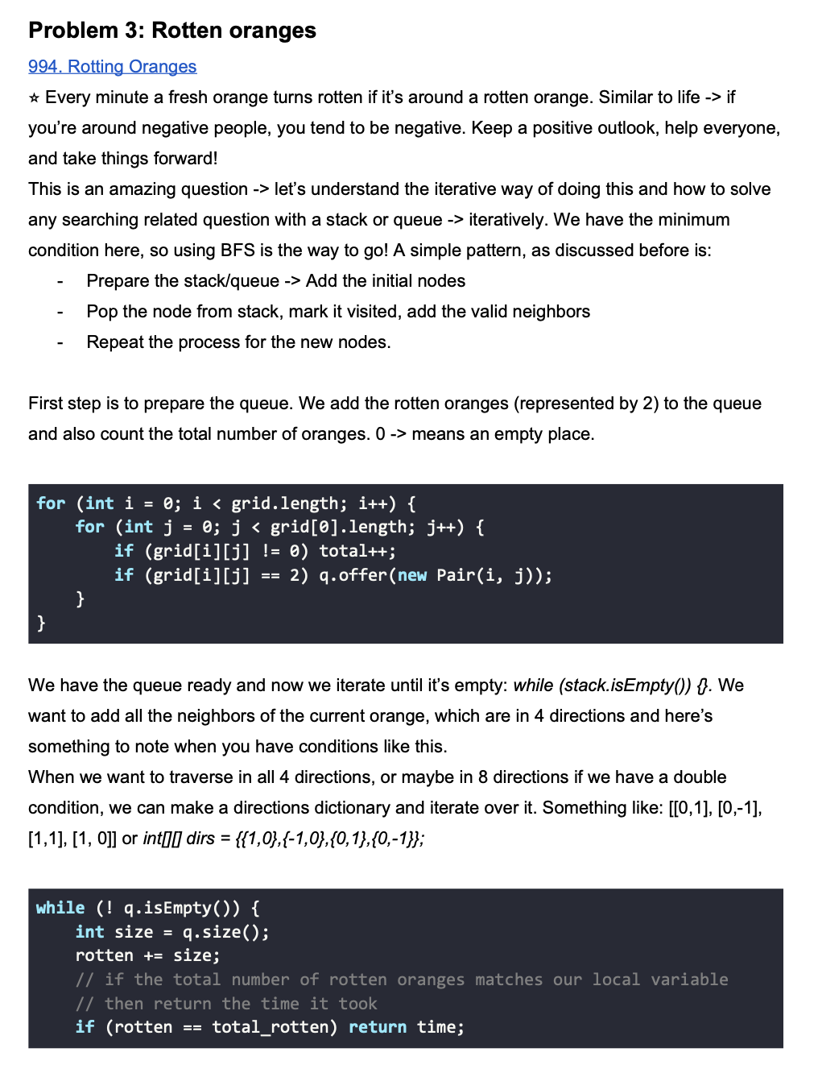
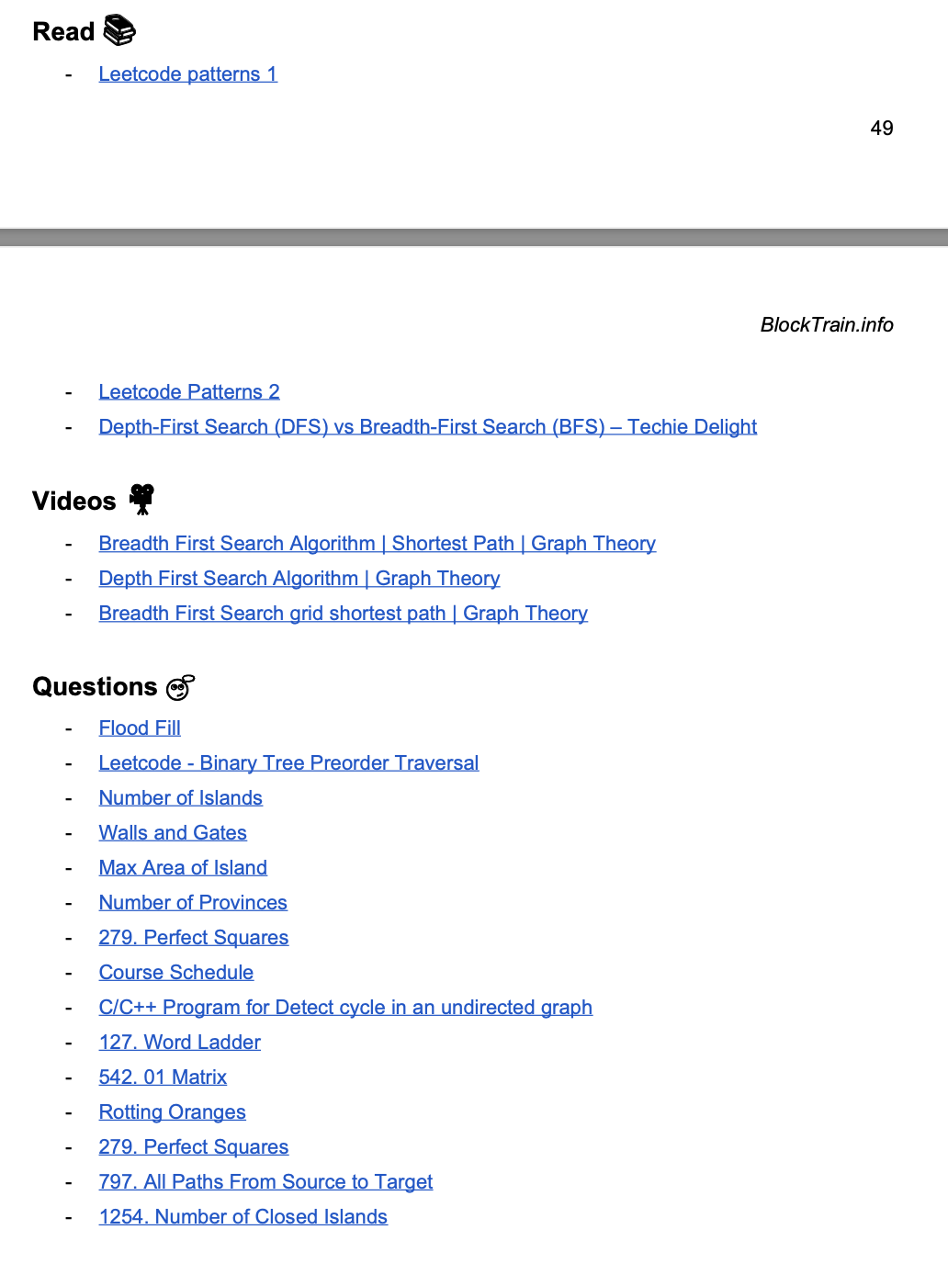

Slide 18


Slide 19
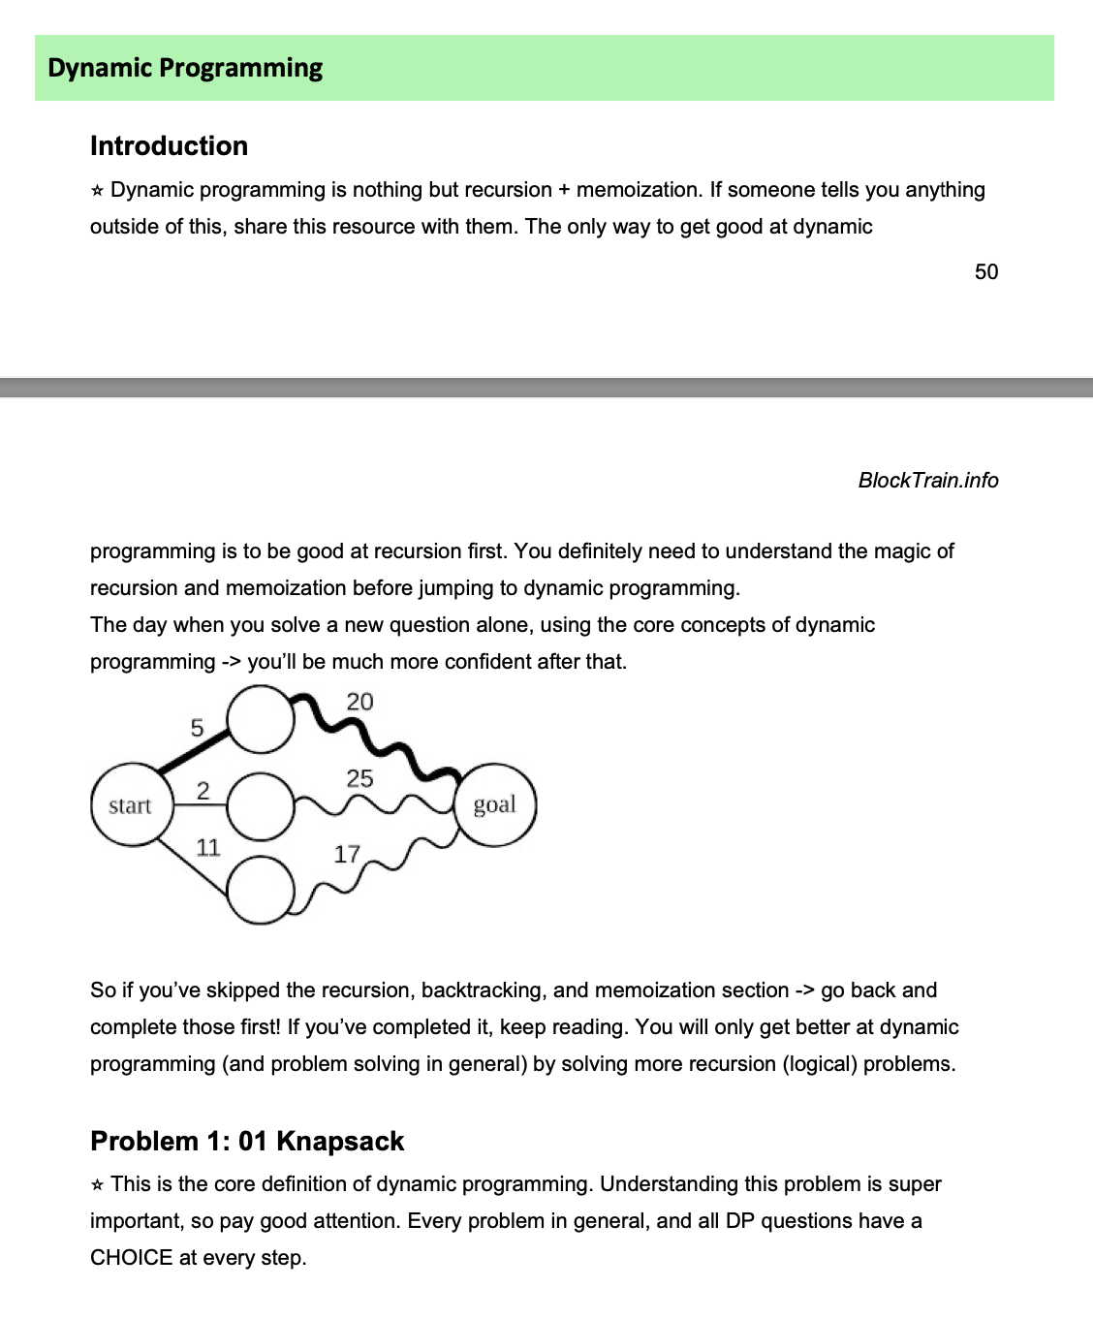
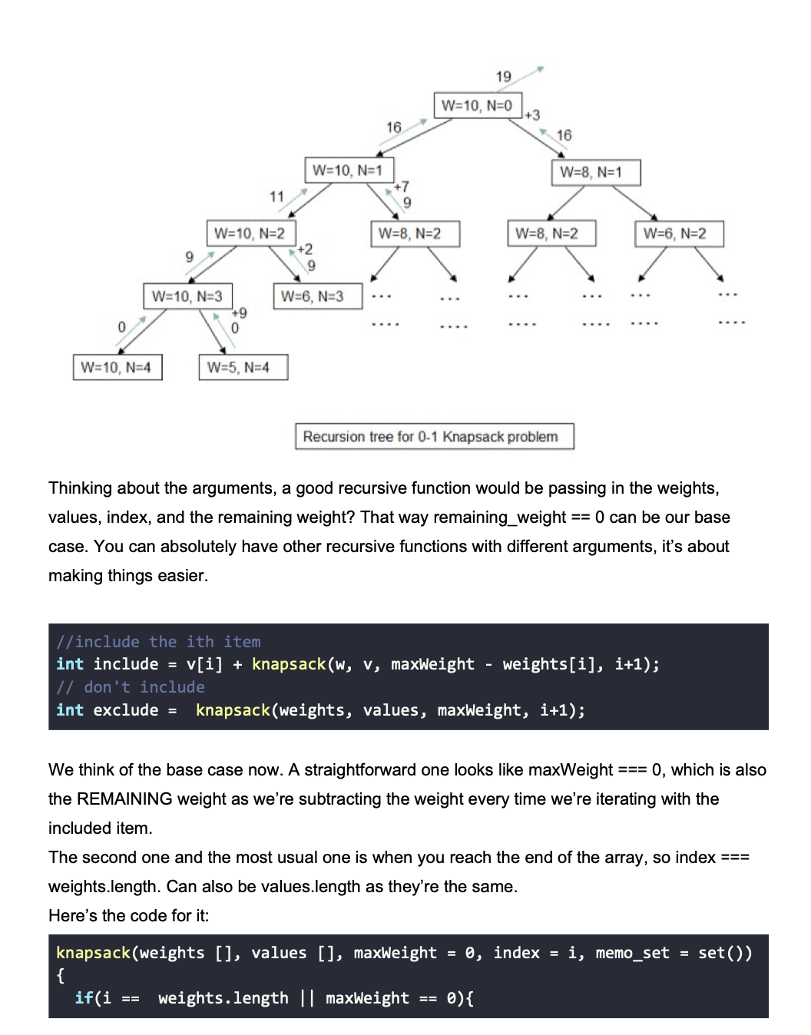

Slide 20
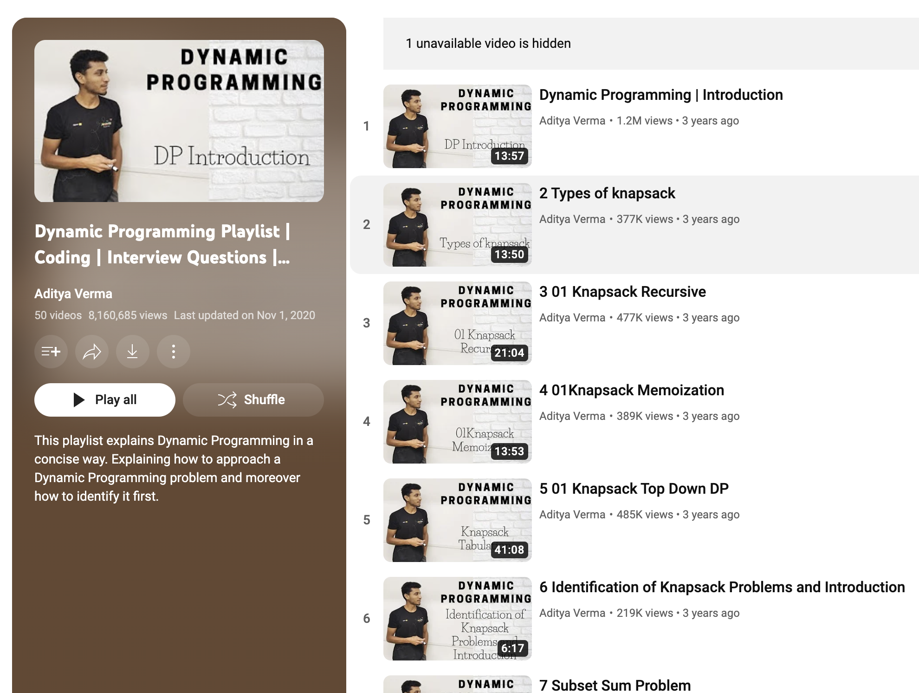
https://www.youtube.com/playlist?list=PL_z_8CaSLPWekqhdCPmFohncHwz8TY2Go
Best DP playlist
For hindi - codebix

Slide 21
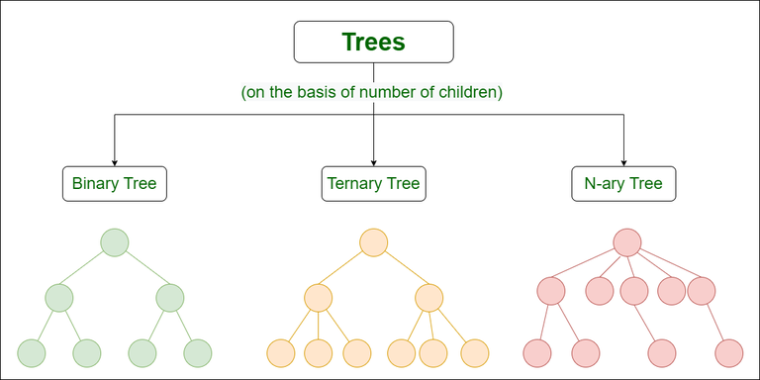

Slide 22
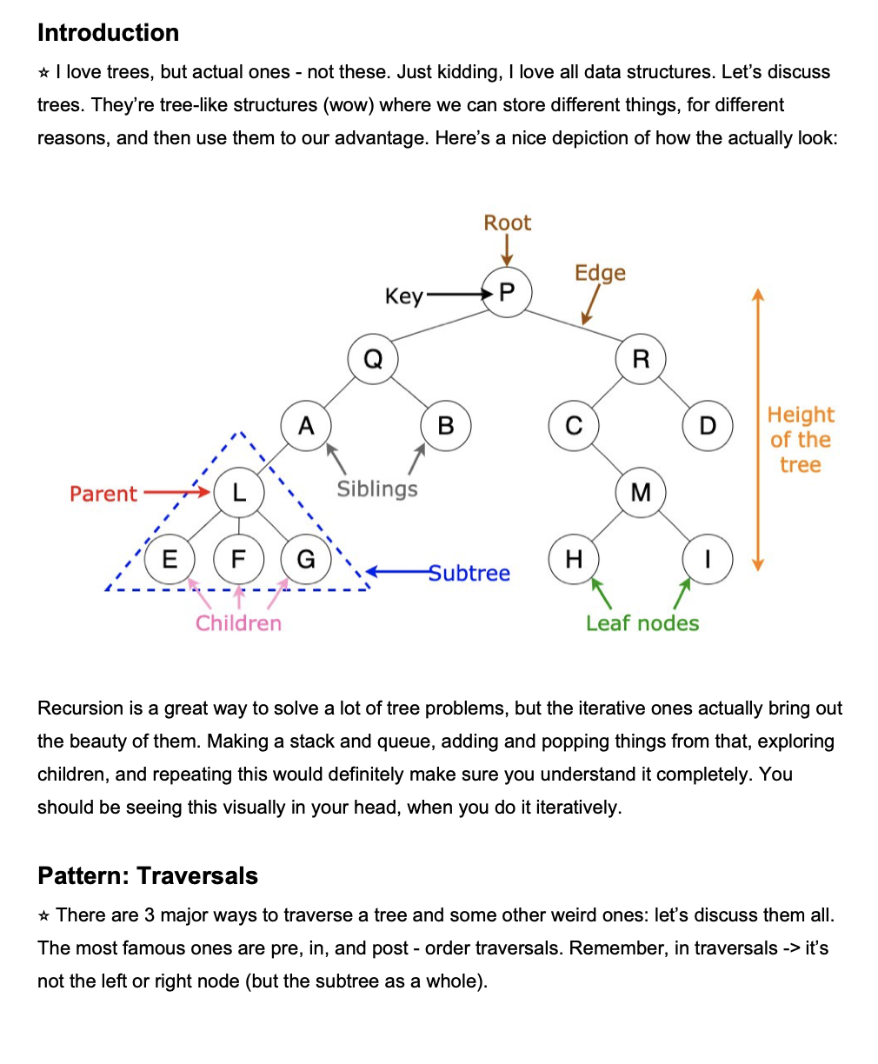
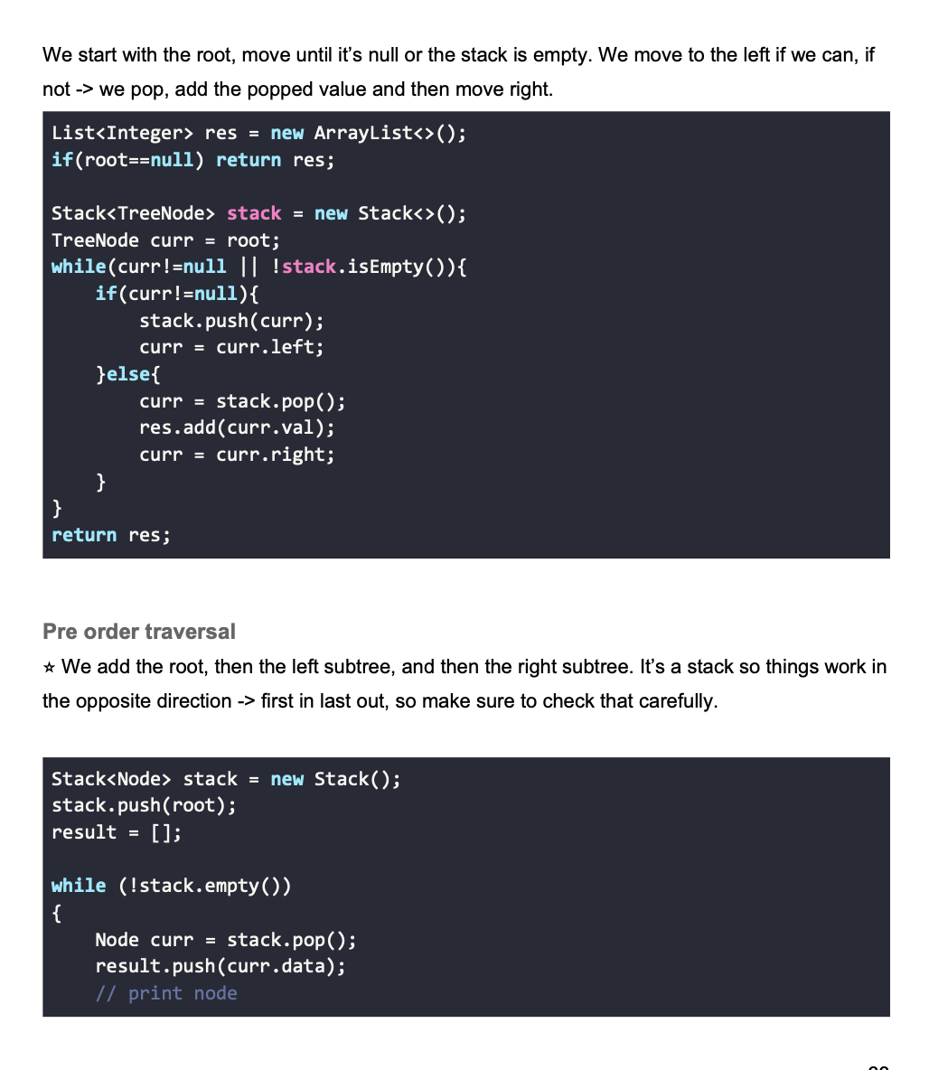

Slide 23
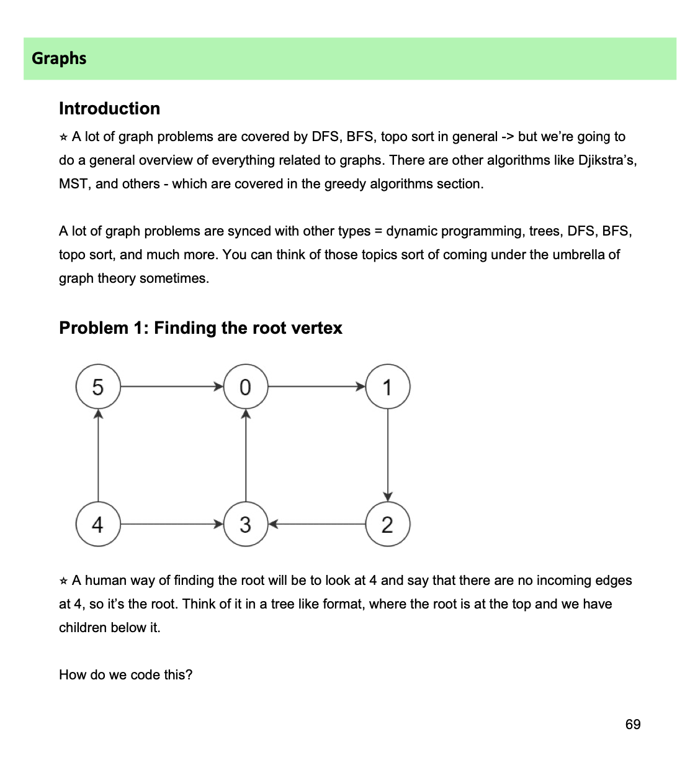
Graphs
Searches
Finding something
Flights, comparison Qs
Coloring, visited, etc
Cyclic components
Connected components

Slide 24
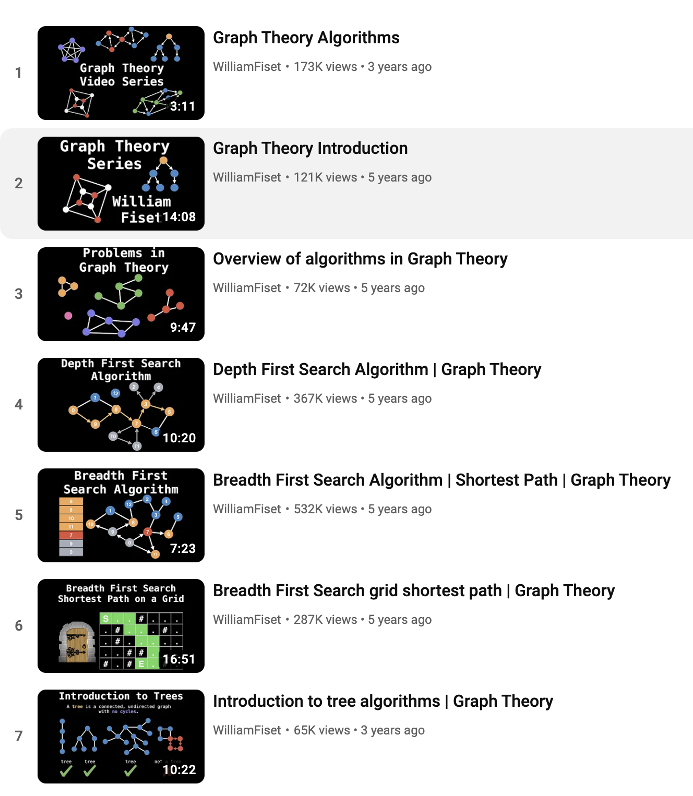
https://www.youtube.com/playlist?list=PLDV1Zeh2NRsDGO4--qE8yH72HFL1Km93P
William fiset - amazing graph

Slide 25
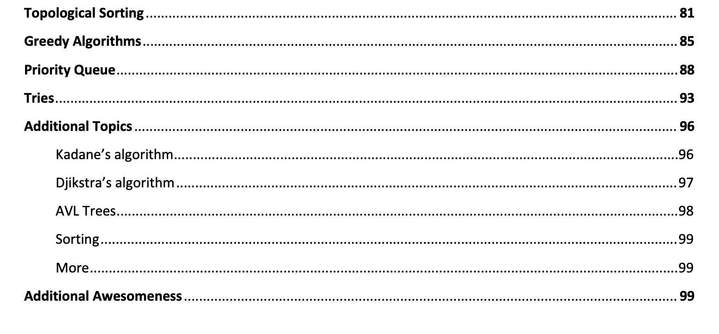
ADDITIONAL TOPICS - IMPORTANT

